Slide 1
Fraud Detection in the Card Payments Data
A supervised learning process
Team 4
Chong Li
Jie Chen
Raman Deep Singh
Xiaowen Zhang
Yu Dong

Slide 2
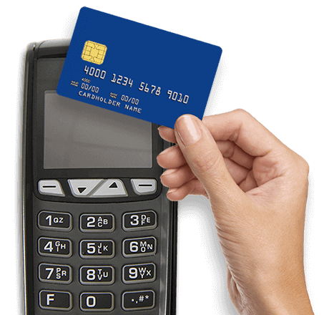
Methodology
•Tools: R, Python, Tableau
•Supervised Machine Learning Algorithms:
Naive Bayesian, Logistic Regression, Random Forest, Neural Network, SVM
•Feature Selection Methods:
Forward Selection and Mutual Information
•Best Model:
In top 1% records: FDR 99.7%, ROI $166,049

Slide 3

Data Overview
•95,007 records of card transaction
•From 2010-01-01 to 2010-12-31
•298 labeled fraudulent records
•10 variables in total – 1 numeric, 7 categorical, 1 text, 1 date
•Numeric: amount
•Categorical: recordnum, cardnum, merchnum, merch.state, merch.zip, transtype, and fraud
•Text: merch.description
•Date: date

Slide 4
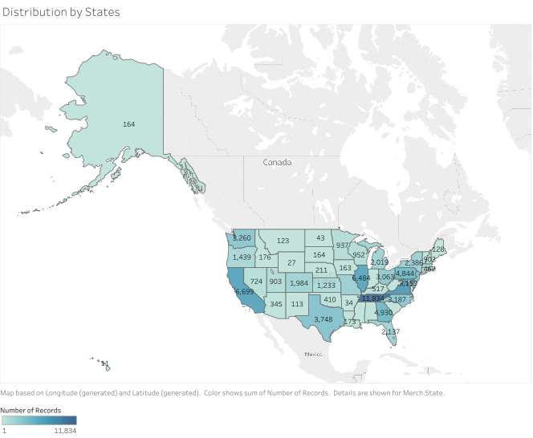
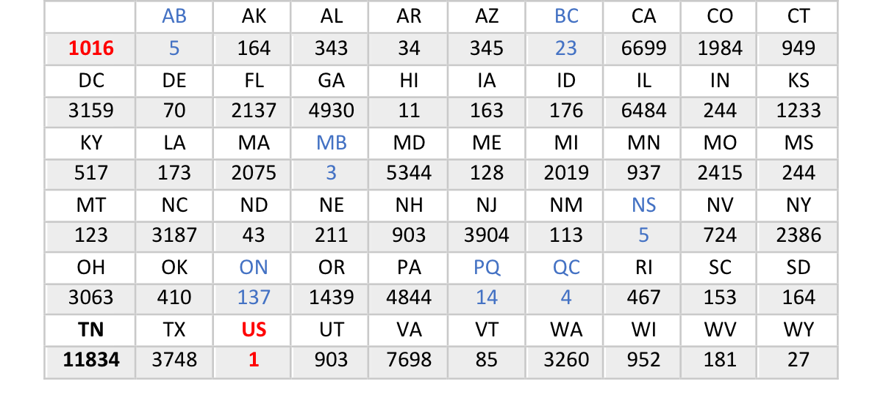
Data Overview -
Merchant State

Slide 5
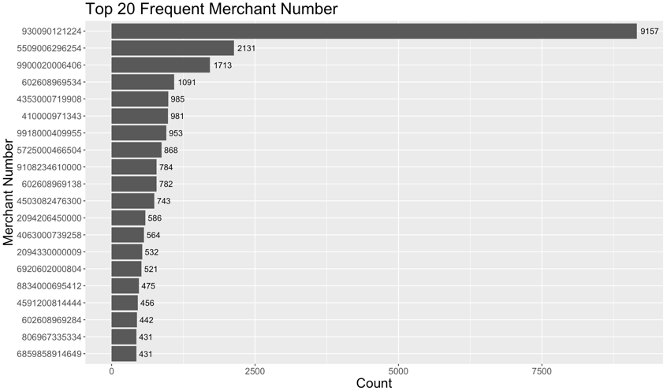
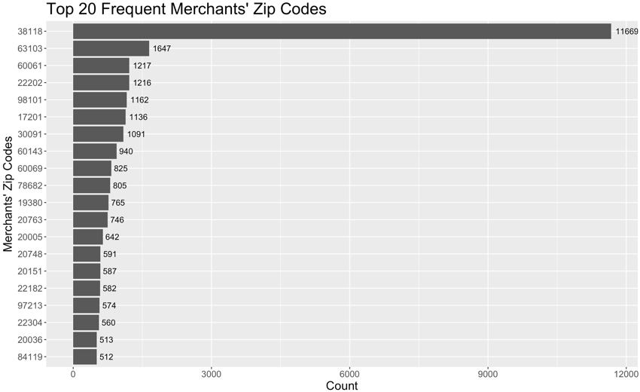
Data Overview
Merchant Number
Merchant Zip Code
•3174 missing values, 53 0’s
•13.01% invalid values

Slide 6
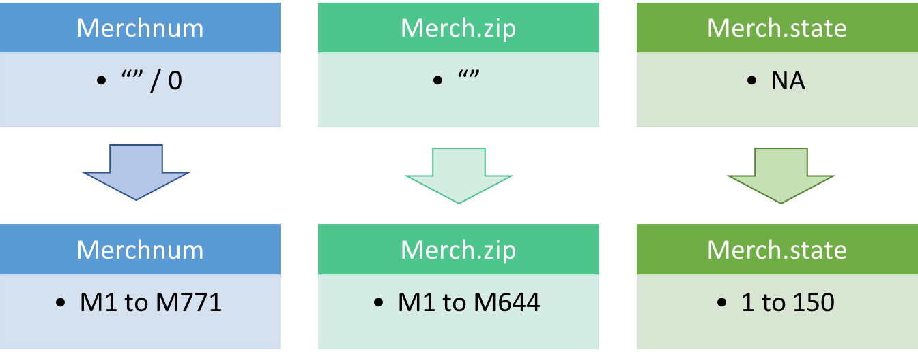
Data Overview
•Assumption: 1 merchant, 1 description, 1 merchant number, 1 zip code, 1 state

Slide 7

Building variables
56 expert variables in total
4 Types of expert variables
Wrote ‘for’ loops to create different types of variables
5-8 min for each variable
Whole process 6 hours
Time window 3, 7, 14, 28 days
Notes:
the total time we spent on building variables is about 6 hours

Slide 8
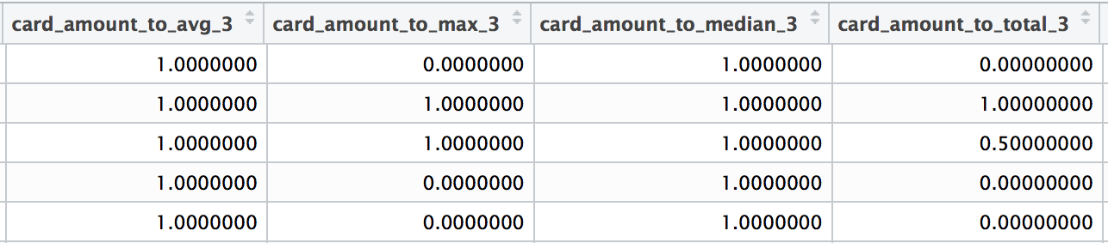
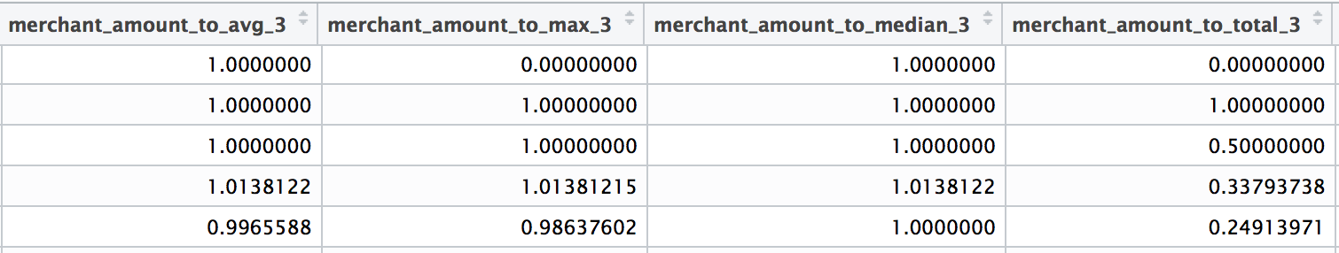
Building variables
1) Type I variables are intended to capture unusual amounts of transaction, both at the card level and the merchant level. There are 32 type I variables in total.
Example: card_amount_to_avg_14 tells if a particular transaction amount is unusual compared to historical averages of the past 14 days.
Notes:
We built variables through link analysis based on the key idea of ‘comparison’.
We also have variables describing the transaction
amount compared with historical maximum/median/total at both card level and merchant level. What to be noted is before we created this set of variables, we set a baseline by giving a neural value, either 0 or 1, to the first amount of each merchant number or card number. This was because we couldn’t determine whether the first transaction for each merchant or card is fraud or not by all means, and thus we gave them a neural value to make it a baseline.

Slide 9
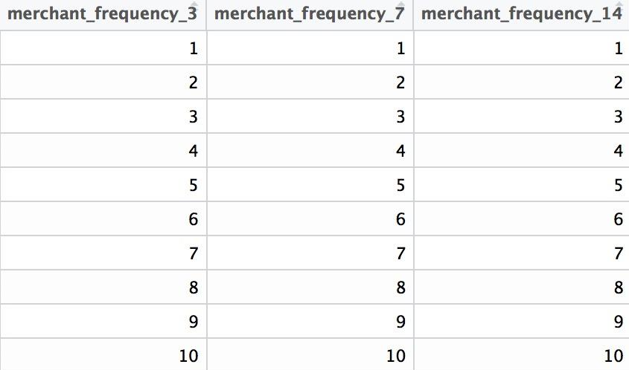
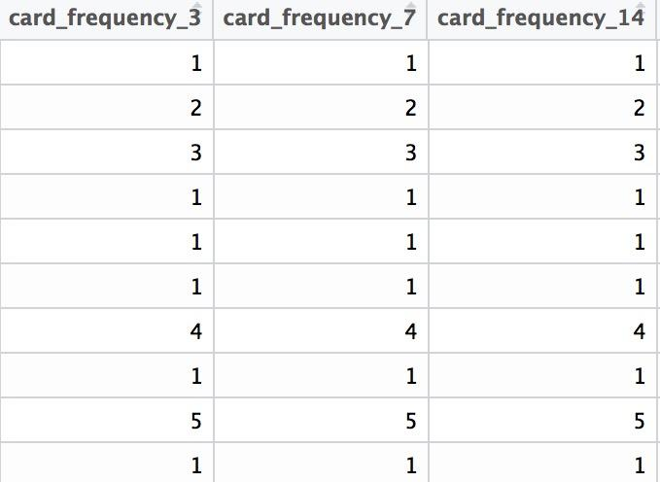
Building Variables
2) Type II variables are intended to capture unusual transaction frequency during a set period of time, both at the card level and the merchant level. There are 8 Type II variables in total.
Example: card_frequency_3 describes the transaction frequency for each specific card number in the past 3 days

Slide 10
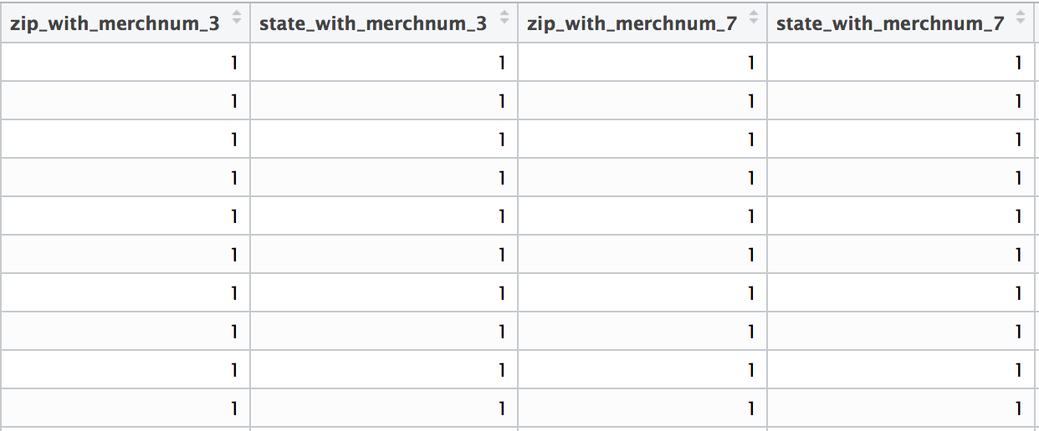
Building Variables
3) Type III variables are location related variables, which are intended to capture merchants or cards that appear in many different regions in a set period of time. There are a total of 8 type III variables.
Example: zip_with_merchnum_3 tells how many zip codes are related with a particular merchant in the past 3 days.
Notes:
We built this type of variables based on the assumption that a normal merchant or cardholder will not have activities in many different locations at the same time. So if we see any unusually high numbers, we’ll suspect there is something going on.

Slide 11
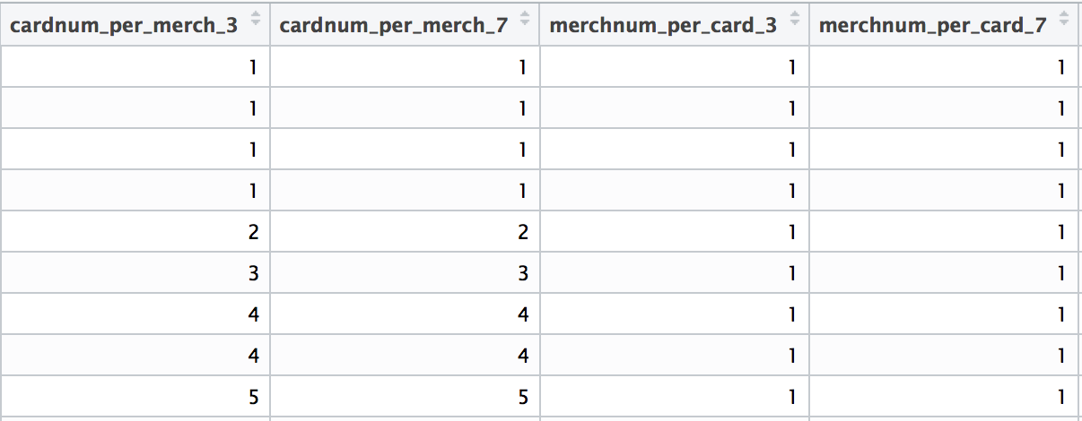
Building Variables
4) Type IV variables are intended to catch fraudsters using purchasing pattern. There are a total of 8 type IV variables.
Example: merchnum_per_card_3 tells how many different merchants have a particular card been used at in the past 3 days.
Notes:
We built the type IV variables based on the assumption that a normal cardholder typically shops in a certain set of places, and it is unusual if they suddenly shop at many different stores. The same assumption applies to merchants, we assume that a normal merchant will have roughly same number of customers in a short period of time. So if there is a surge in number of cards used at this merchant we would be suspicious.

Slide 12
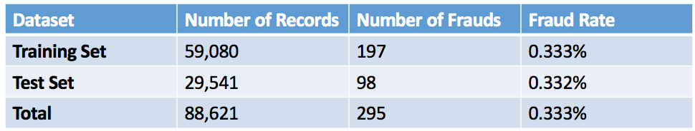
Fraud Algorithm - Training/Test Split

Slide 13
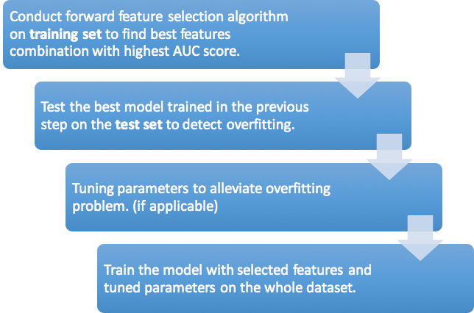
Fraud Algorithm - Forward Feature Selection

Slide 14
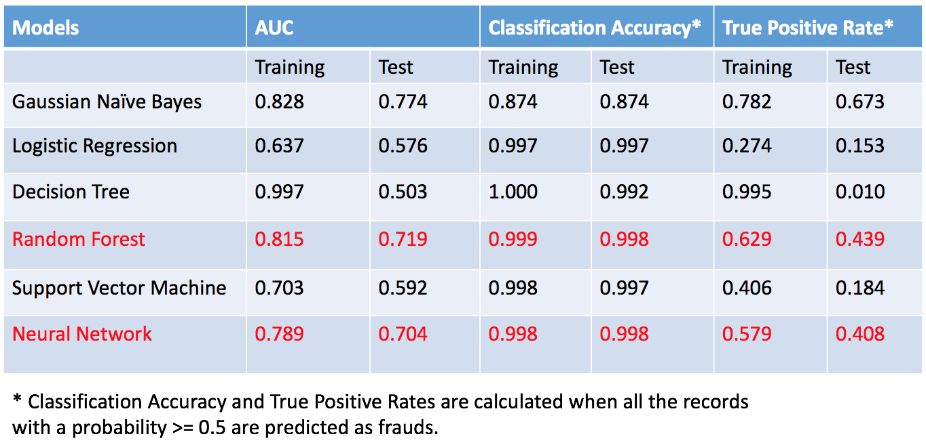
Fraud Algorithm - Forward Feature Selection

Slide 15
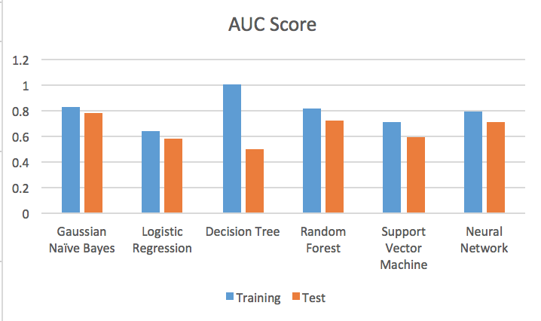
Fraud Algorithm - Model Comparison

Slide 16
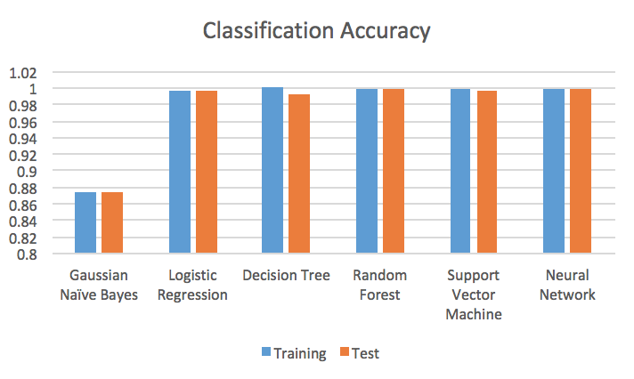
Fraud Algorithm - Model Comparison

Slide 17
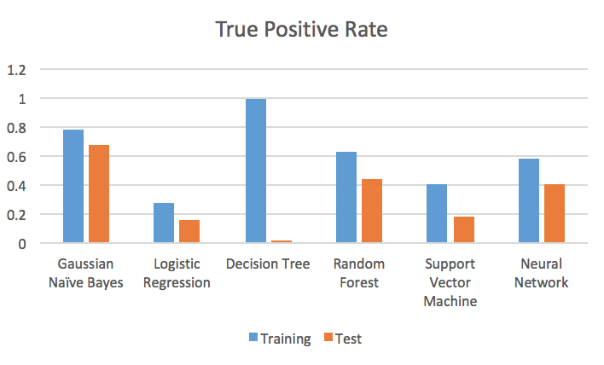
Fraud Algorithm - Model Comparison

Slide 18
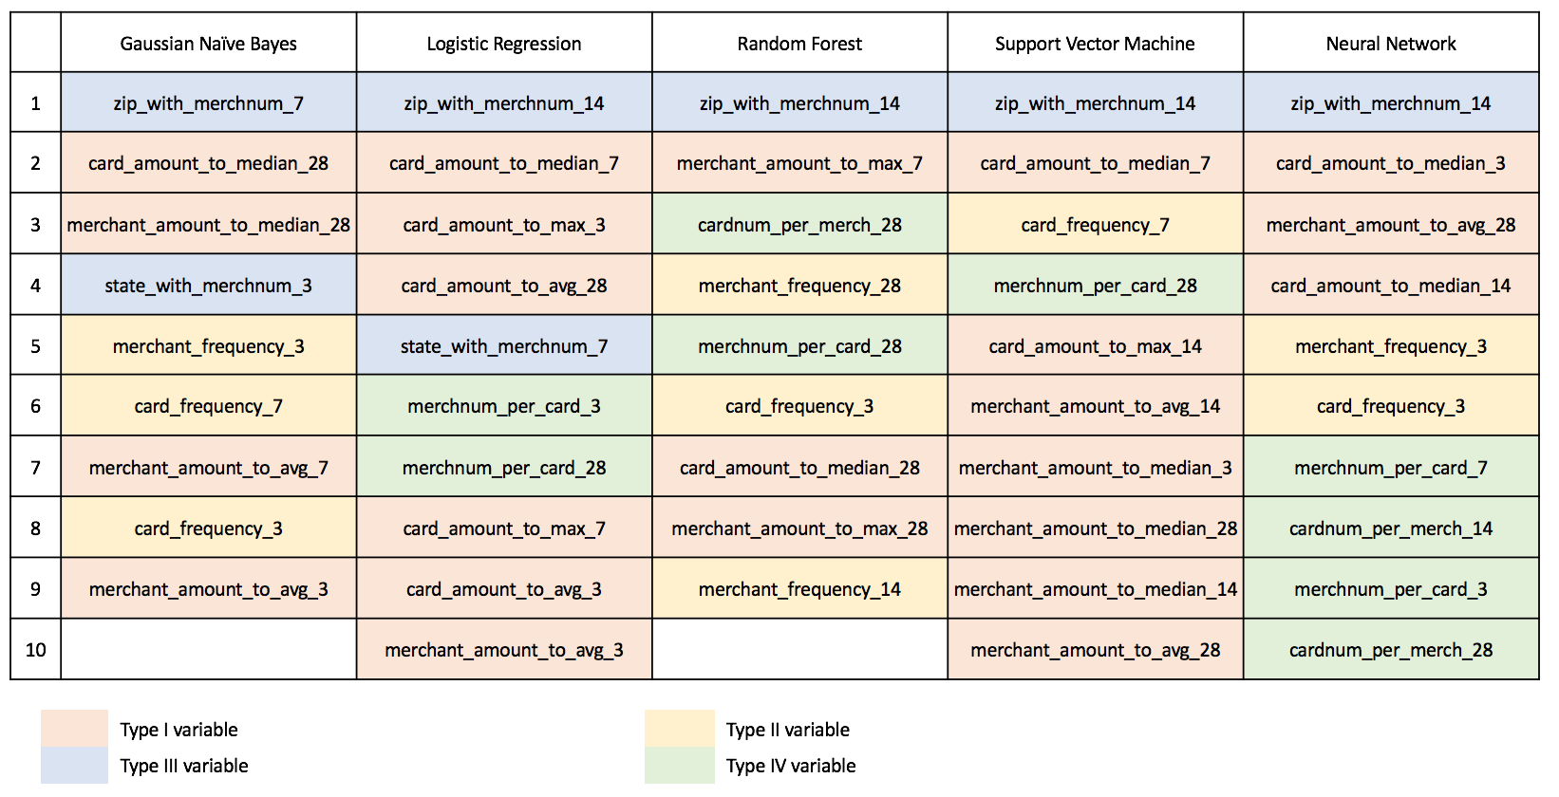
Fraud Algorithm - Selected Variables

Slide 19
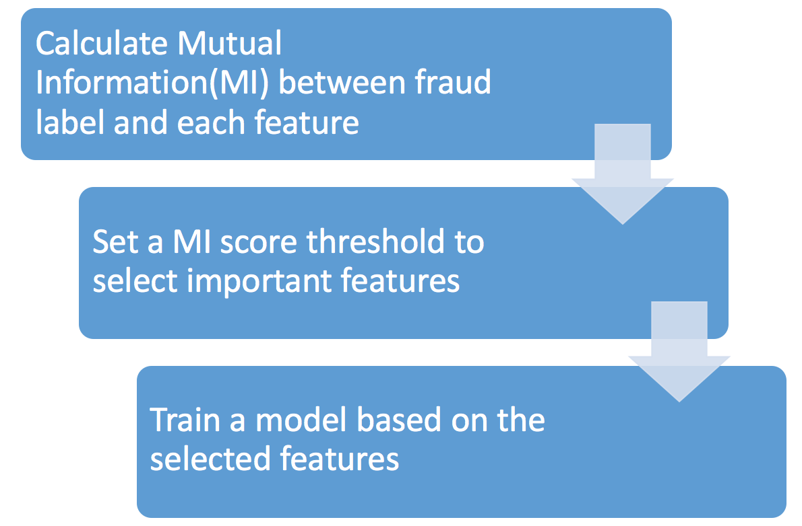
Fraud Algorithm - Mutual Information Feature Selection

Slide 20
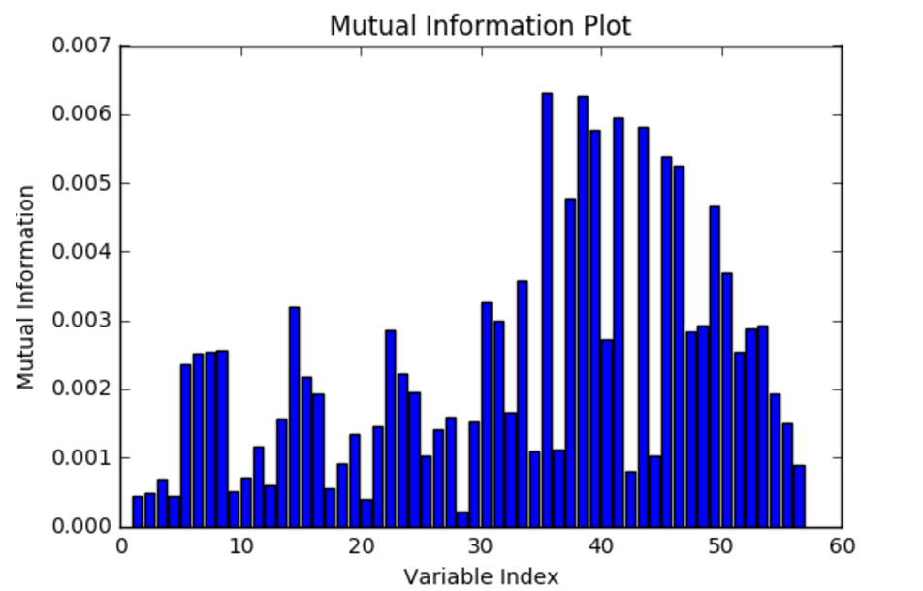
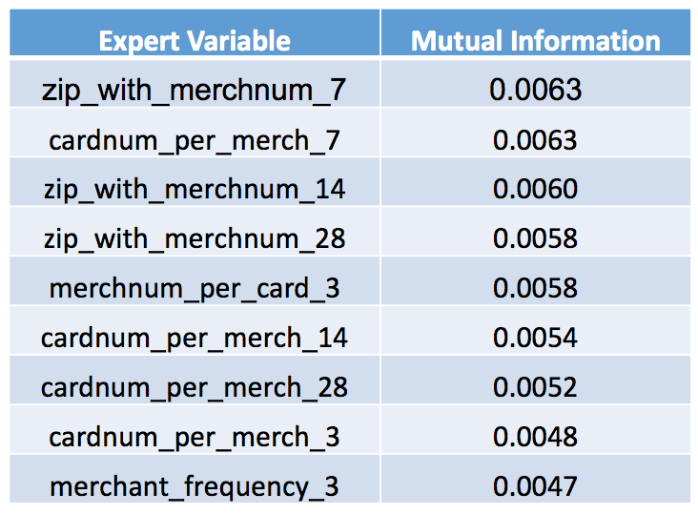
Fraud Algorithm - Mutual Information Feature Selection
7 features
9 features
13 features

Slide 21
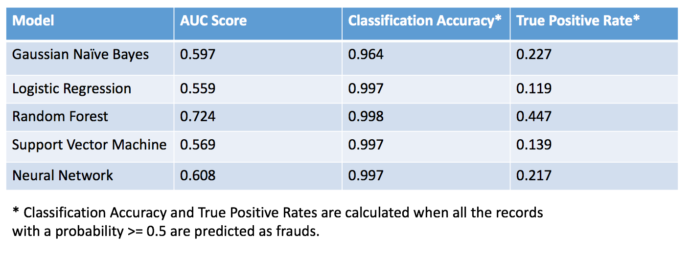
Fraud Algorithm - Mutual Information Feature Selection

Slide 22
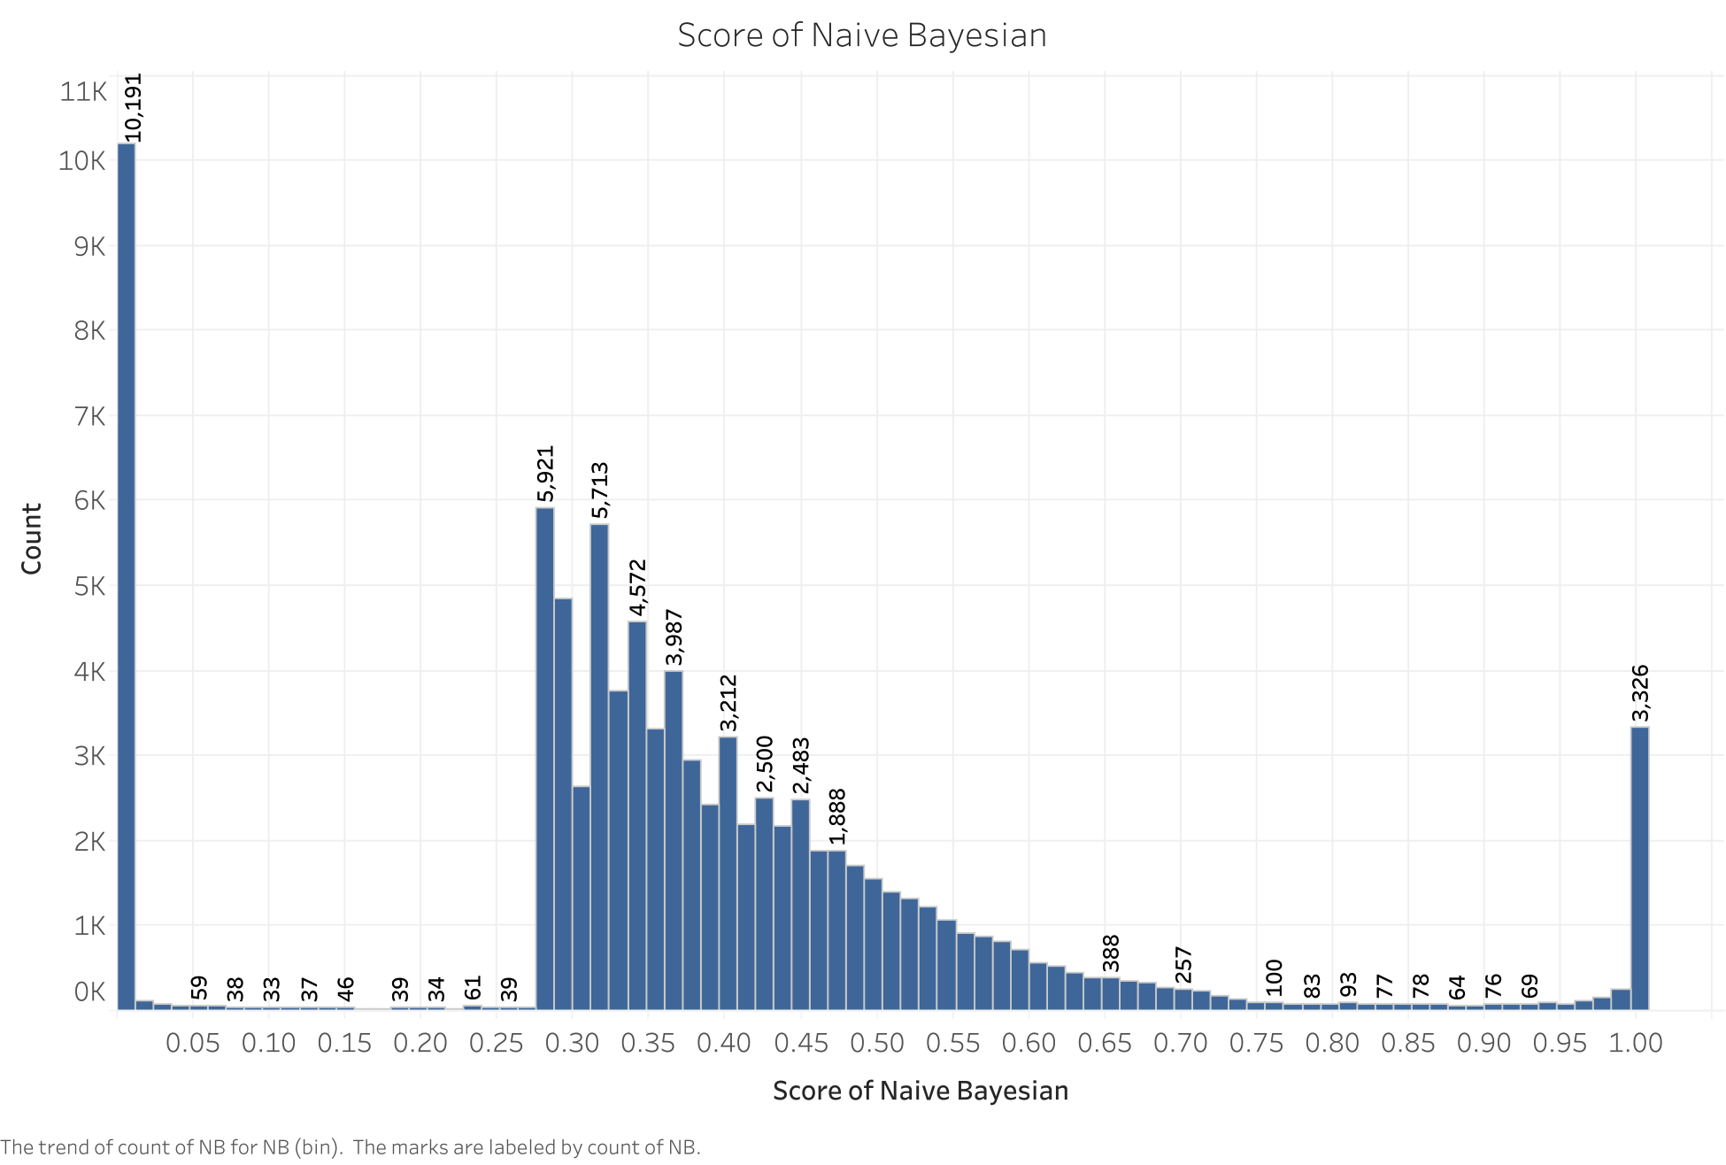
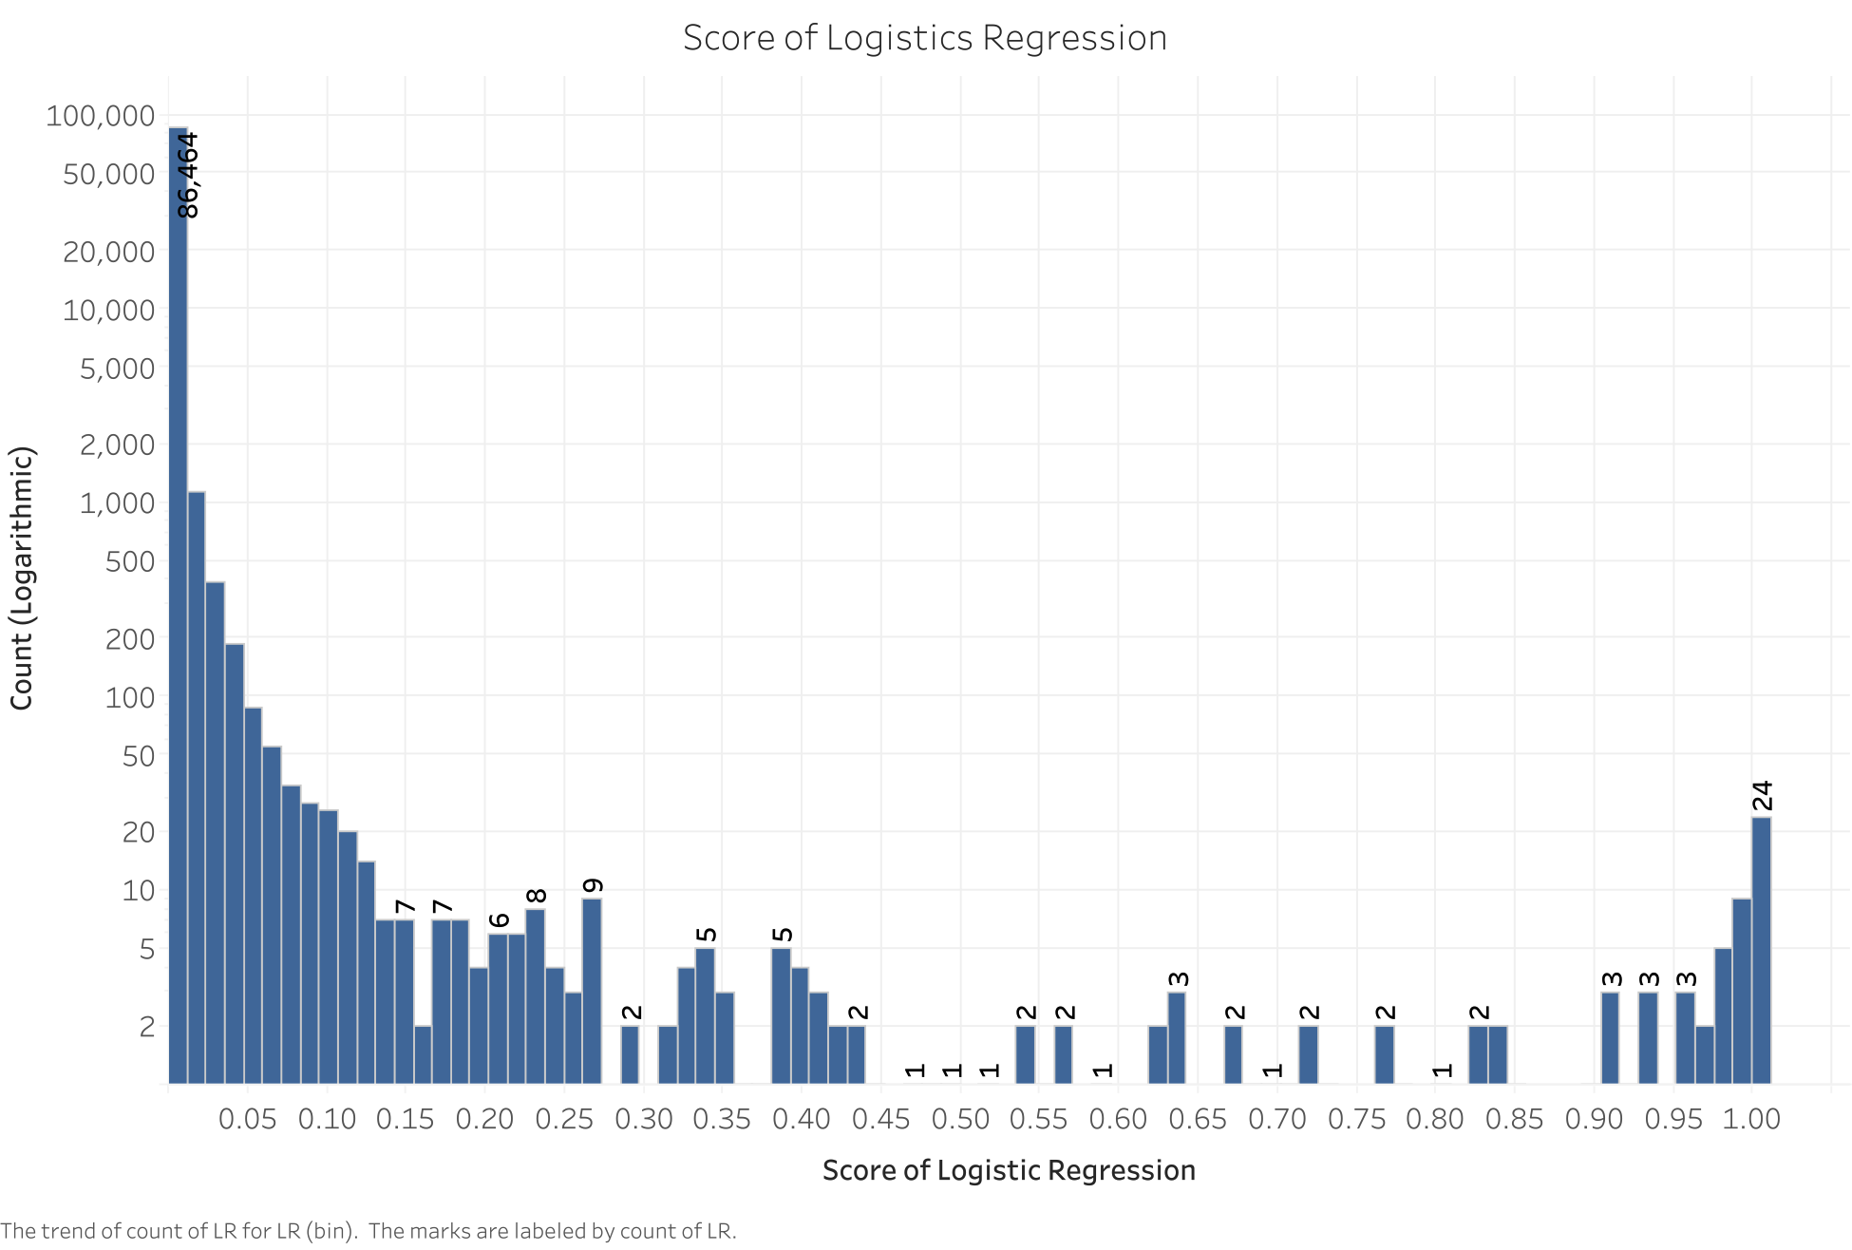
Results - Individual models
Notes:
As Yu talked about earlier we tried many different techniques and in the interest of time I will be showing you the results of 2 of them which worked better than many others. After that I will walk you through the ensemble modeling methods which includes the average of Neural Network and Random Forest and majority model of Neural Network and Random Forest.

Slide 23
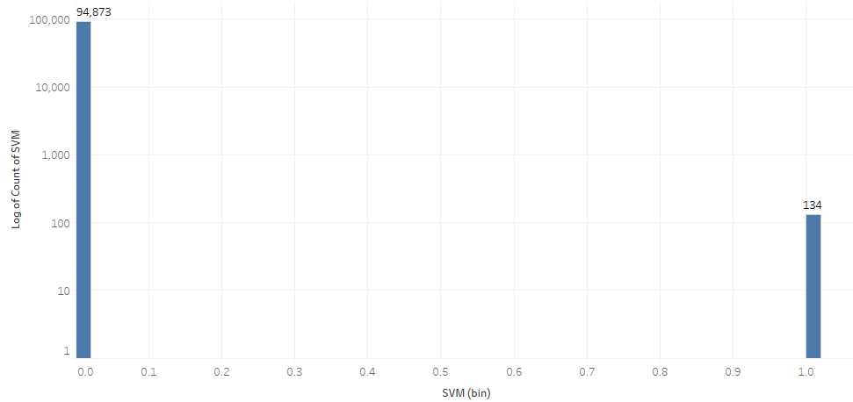
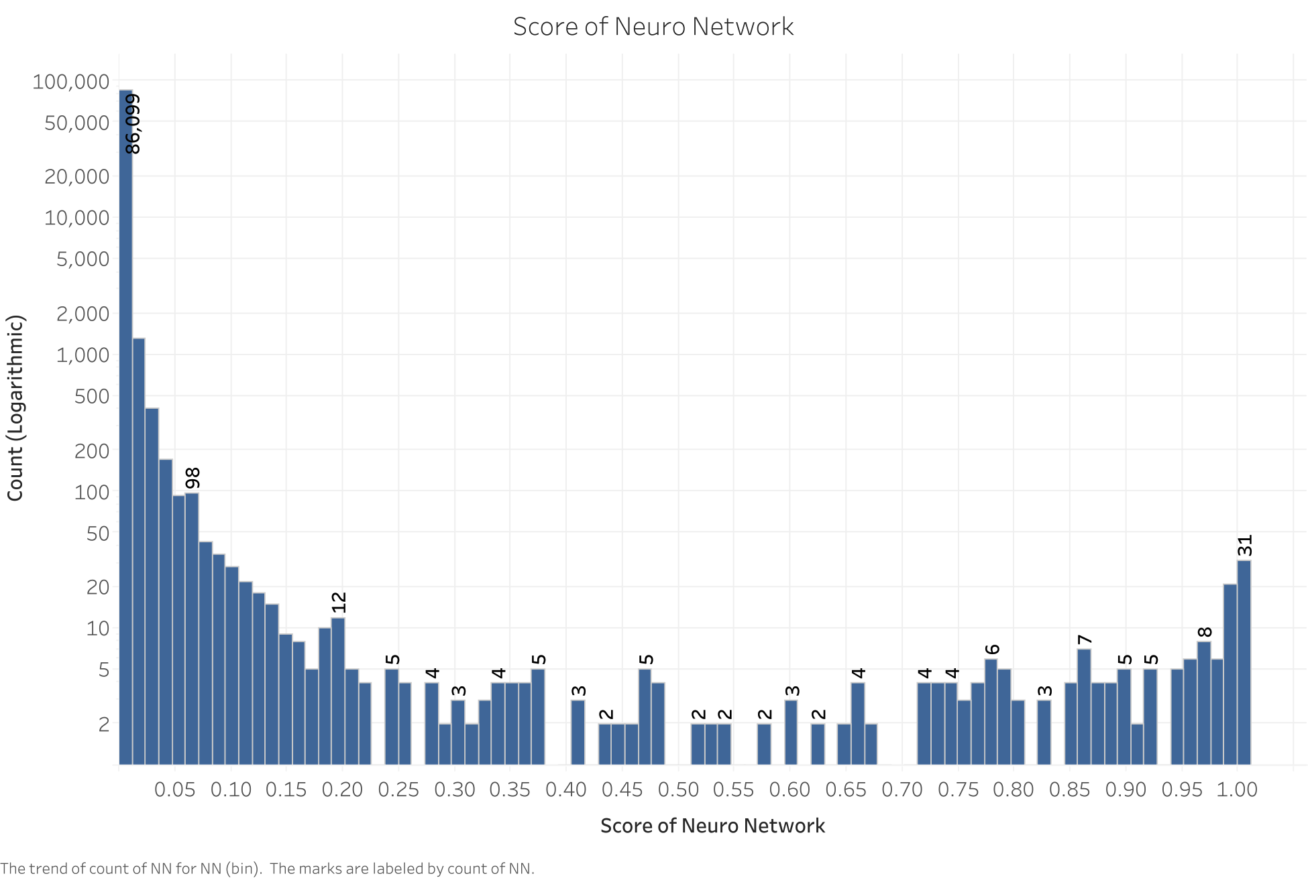
Results - Individual models
Notes:
As Yu talked about earlier we tried many different techniques and in the interest of time I will be showing you the results of 2 of them which worked better than many others. After that I will walk you through the ensemble modeling methods which includes the average of Neural Network and Random Forest and majority model of Neural Network and Random Forest.

Slide 24
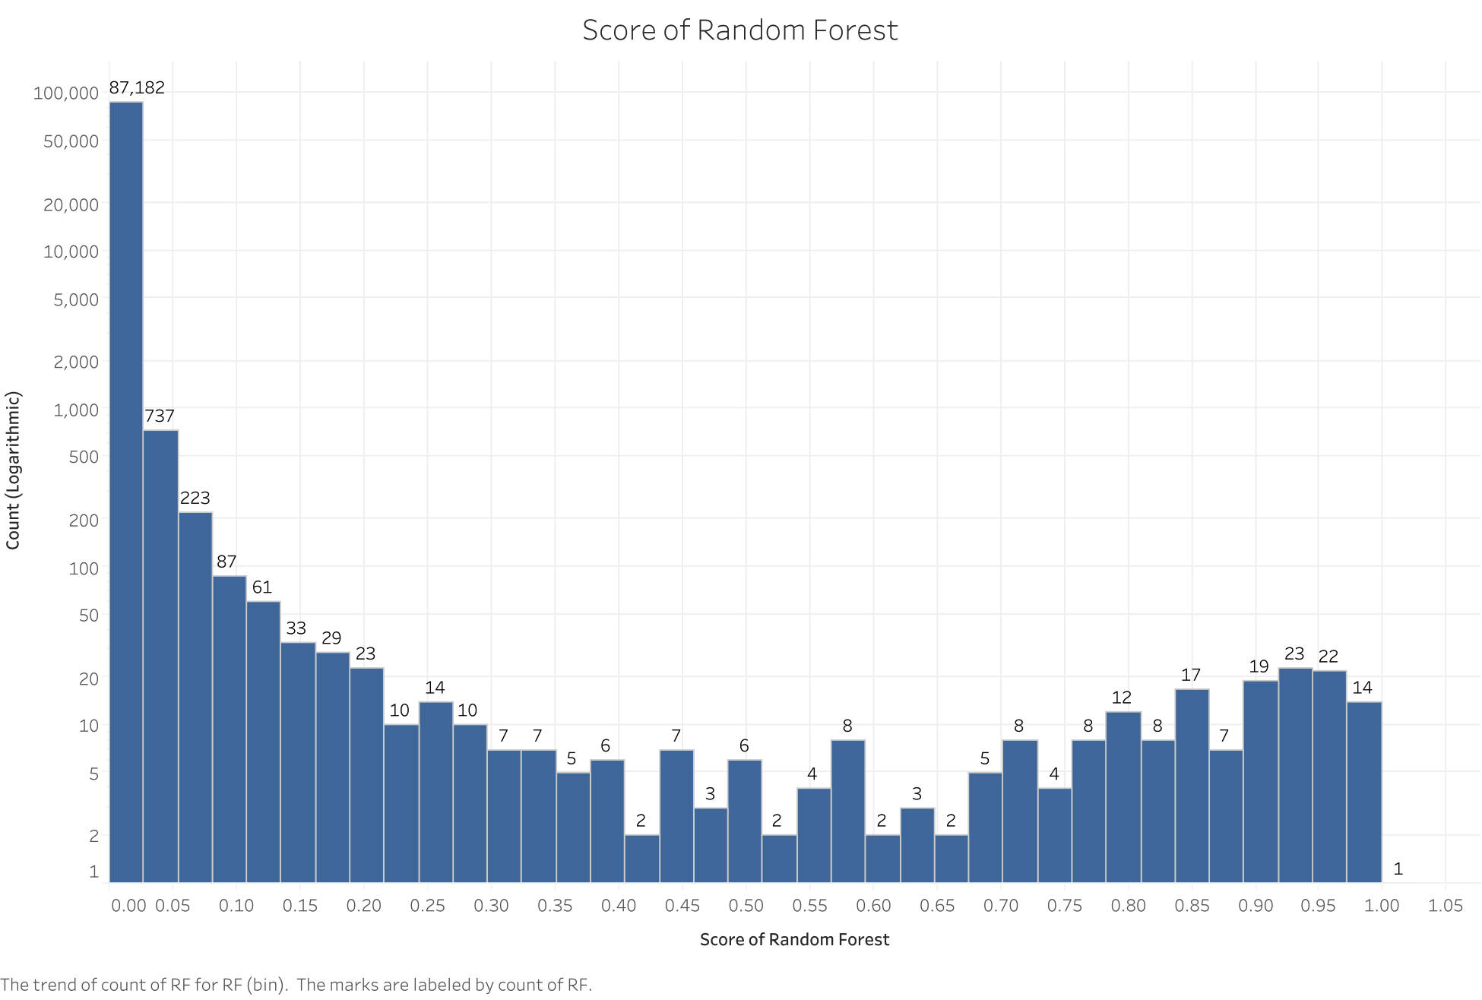
Results - Random Forest
Notes:
As Yu talked about earlier we tried many different techniques and in the interest of time I will be showing you the results of 2 of them which worked better than many others. After that I will walk you through the ensemble modeling methods which includes the average of Neural Network and Random Forest and majority model of Neural Network and Random Forest.

Slide 25
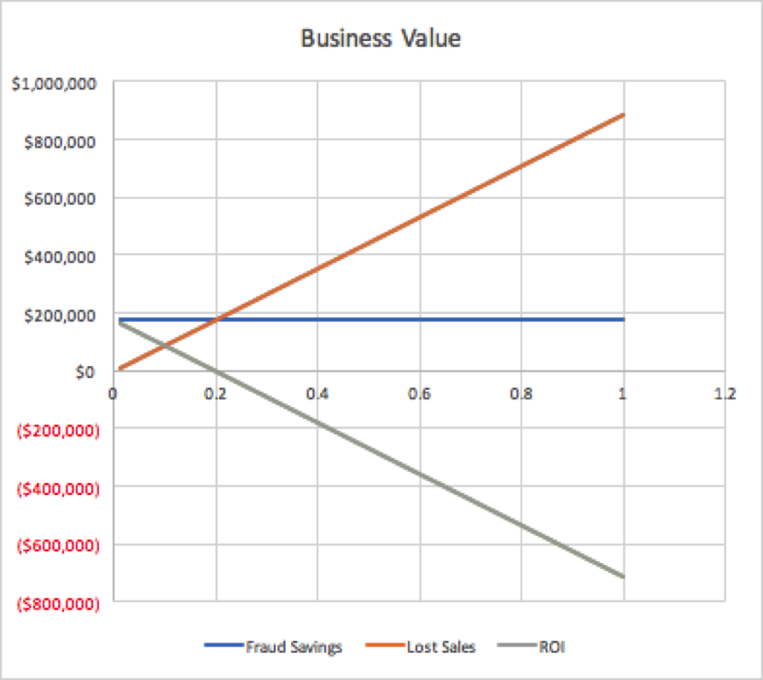
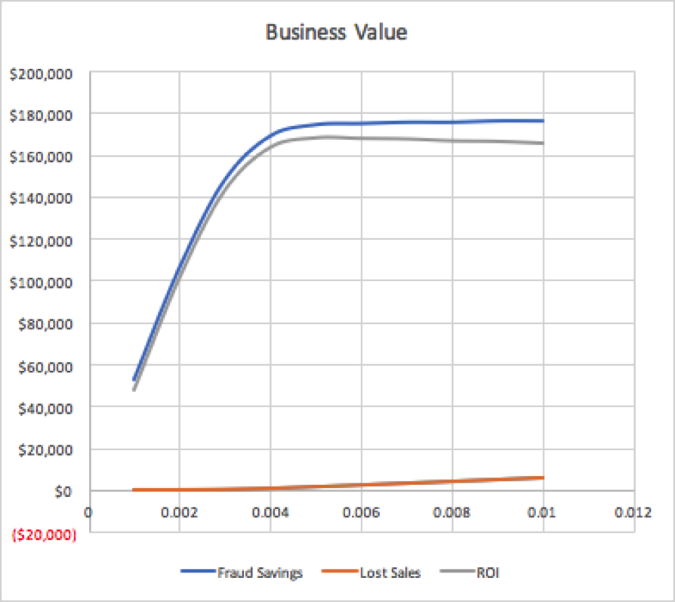
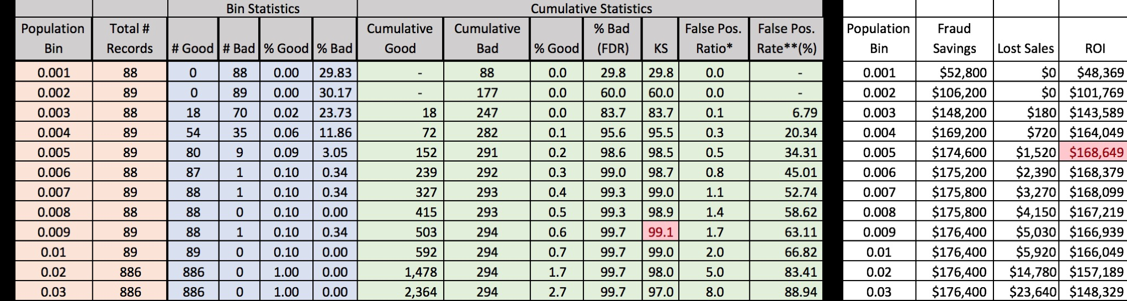
Results - Random Forest
Notes:
As Yu talked about earlier we tried many different techniques and in the interest of time I will be showing you the results of 2 of them which worked better than many others. After that I will walk you through the ensemble modeling methods which includes the average of Neural Network and Random Forest and majority model of Neural Network and Random Forest.

Slide 26
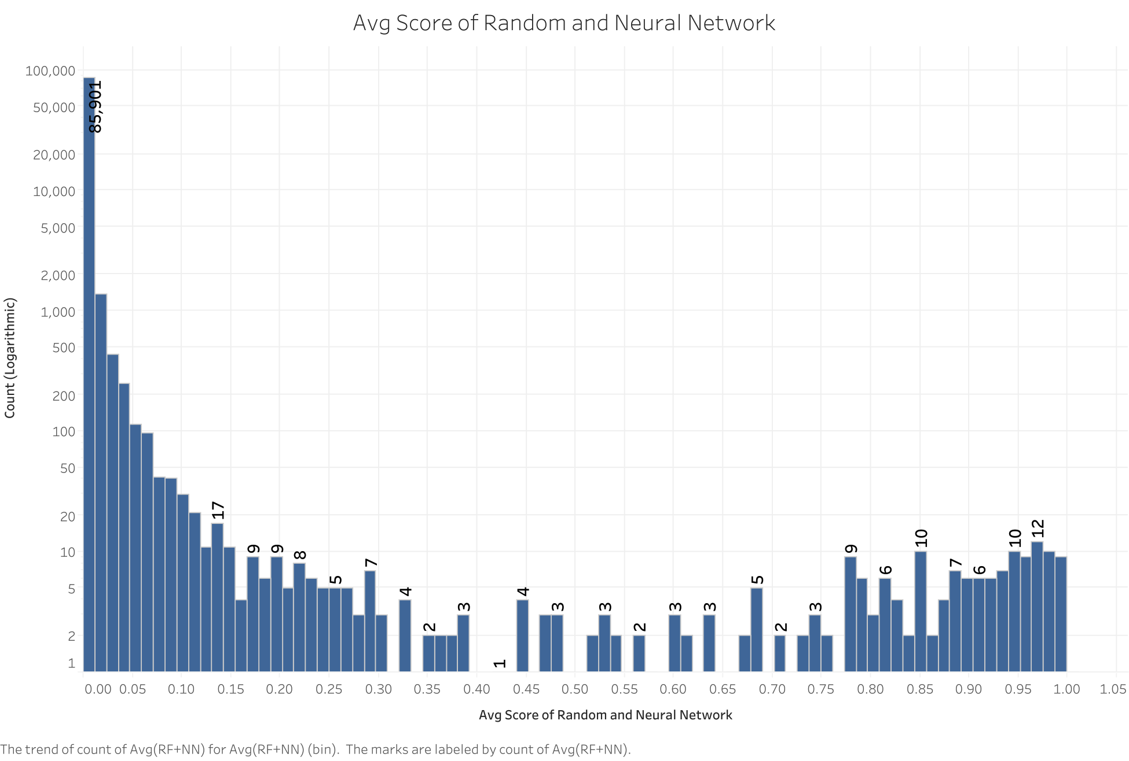
Results - Ensemble Models (Average)
Notes:
As Yu talked about earlier we tried many different techniques and in the interest of time I will be showing you the results of 2 of them which worked better than many others. After that I will walk you through the ensemble modeling methods which includes the average of Neural Network and Random Forest and majority model of Neural Network and Random Forest.

Slide 27

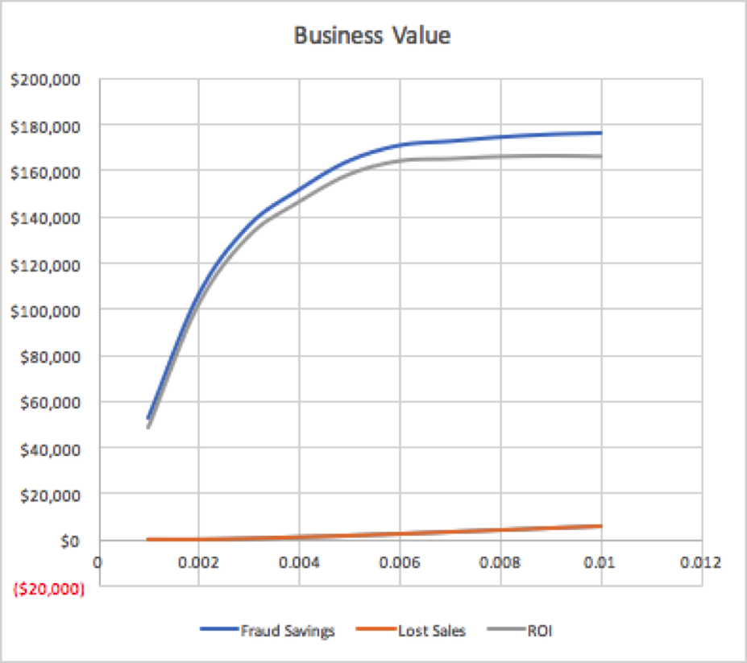
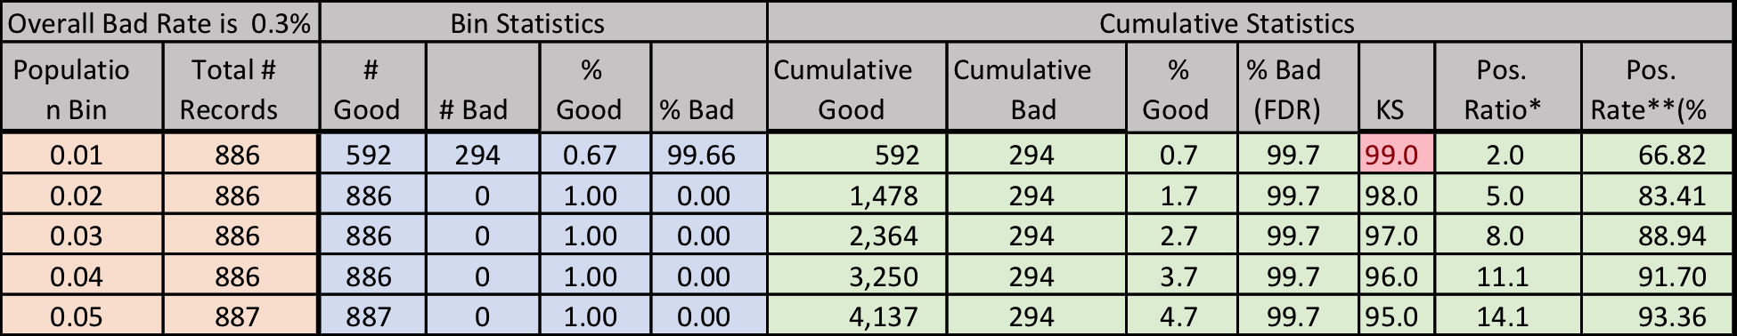
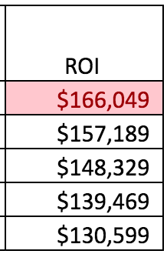
Results - Ensemble Models (Average)
Notes:
As Yu talked about earlier we tried many different techniques and in the interest of time I will be showing you the results of 2 of them which worked better than many others. After that I will walk you through the ensemble modeling methods which includes the average of Neural Network and Random Forest and majority model of Neural Network and Random Forest.

Slide 28
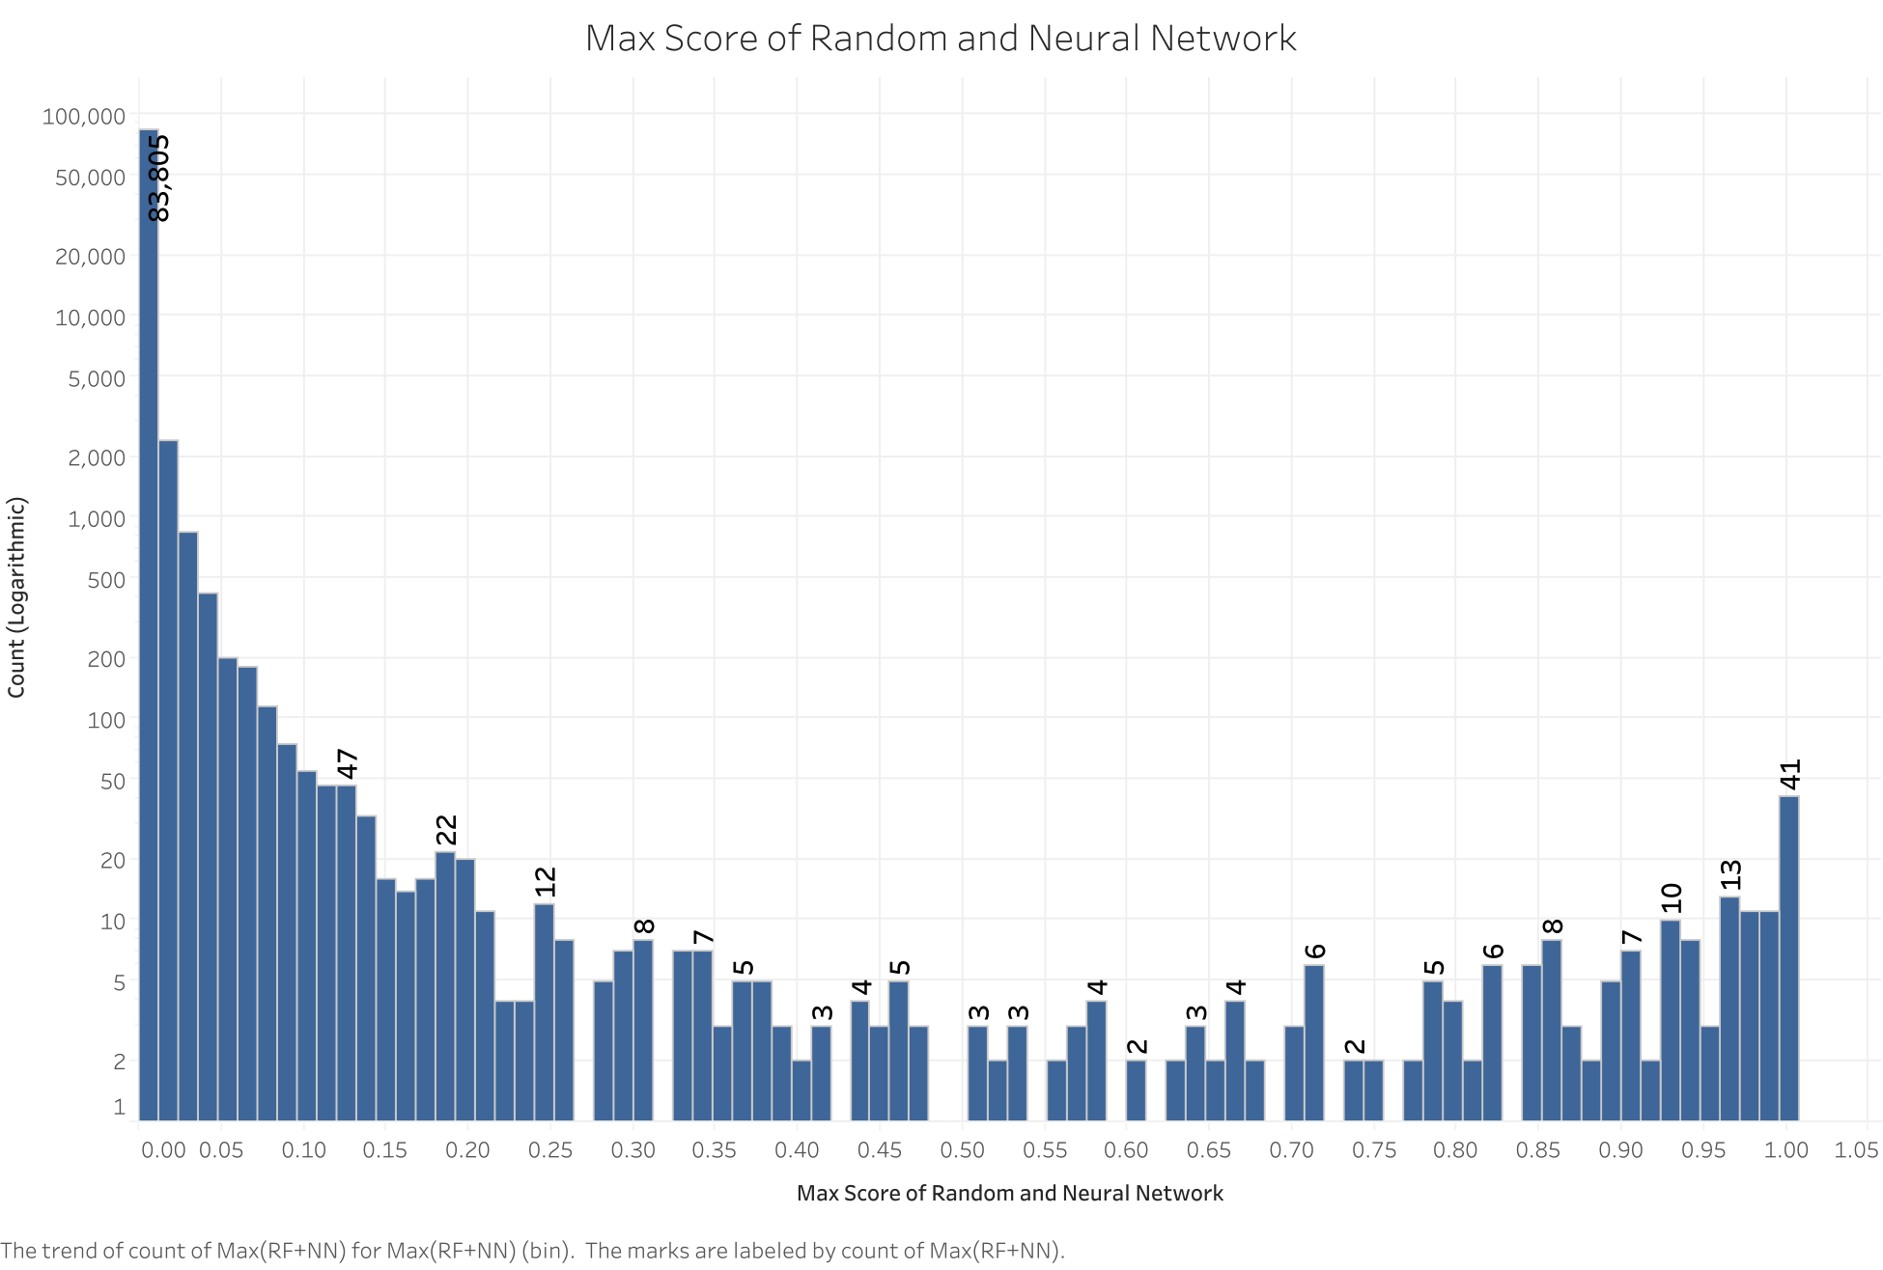
Results - Ensemble Models (Max)
Notes:
As Yu talked about earlier we tried many different techniques and in the interest of time I will be showing you the results of 2 of them which worked better than many others. After that I will walk you through the ensemble modeling methods which includes the average of Neural Network and Random Forest and majority model of Neural Network and Random Forest.

Slide 29
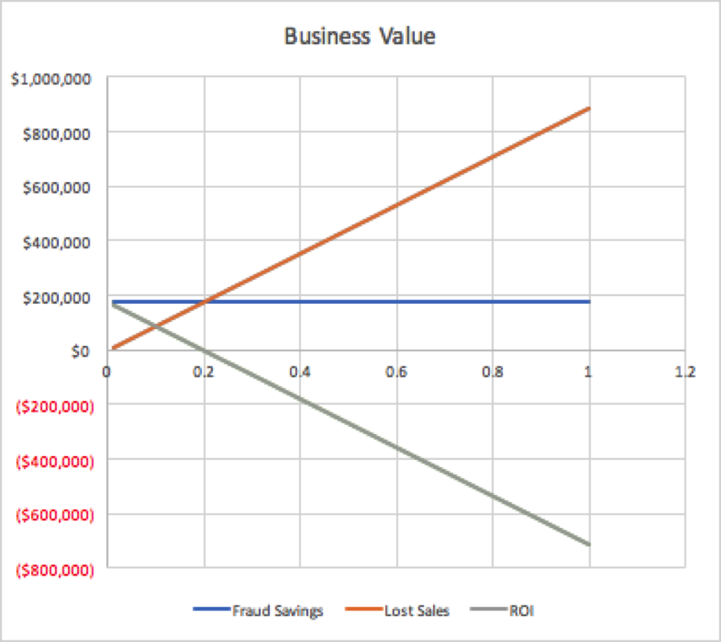
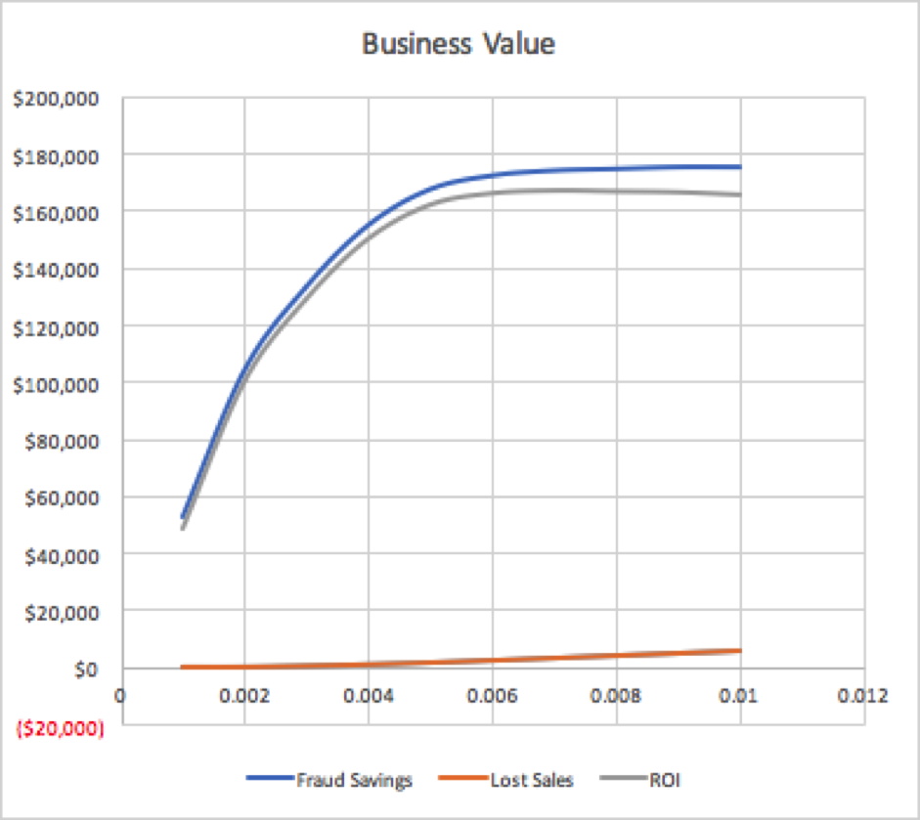

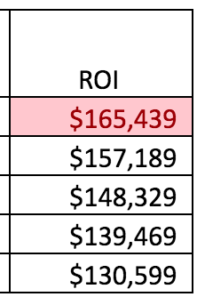
Results - Ensemble Models (Max)
Notes:
As Yu talked about earlier we tried many different techniques and in the interest of time I will be showing you the results of 2 of them which worked better than many others. After that I will walk you through the ensemble modeling methods which includes the average of Neural Network and Random Forest and majority model of Neural Network and Random Forest.

Slide 30

Conclusion
Random Forest Model with the 9 variables selected during the forward feature selection process performs best.
To generate most business value, i.e. ROI, we should flag all the records with top 0.5% score as frauds.
The estimated ROI using the given dataset is $168,649.
Notes:
As Yu talked about earlier we tried many different techniques and in the interest of time I will be showing you the results of 2 of them which worked better than many others. After that I will walk you through the ensemble modeling methods which includes the average of Neural Network and Random Forest and majority model of Neural Network and Random Forest.

Slide 31
Thank you! Any Questions?
Notes:
As Yu talked about earlier we tried many different techniques and in the interest of time I will be showing you the results of 2 of them which worked better than many others. After that I will walk you through the ensemble modeling methods which includes the average of Neural Network and Random Forest and majority model of Neural Network and Random Forest.

